Slide 1
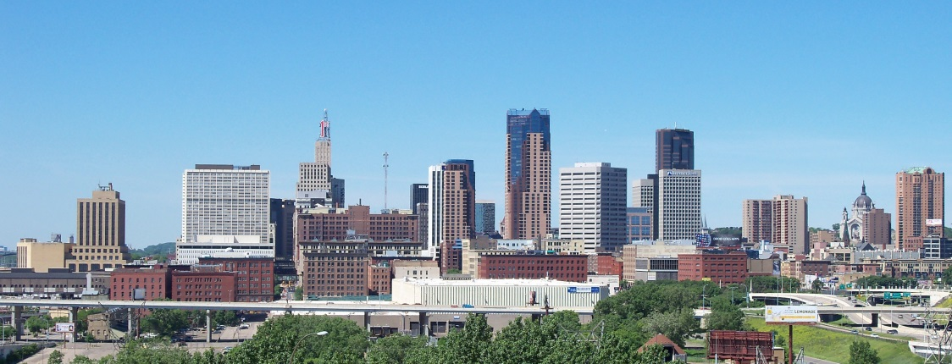
Boards and Commissions Leadership Institute Information Session 2016-17 Terri Thao Program Director Chai Lee Program Coordinator
Notes:
Welcome: Introduce selves

Slide 2
Agenda
About Nexus
Origins of BCLI
Why the BCLI?
The BCLI Model
The Training
Alum Testimony
Important Dates
Q&A
Notes:
Terri

Slide 3
Who is Nexus?
Community-building intermediary since 2003
Target population: Communities of color and other underrepresented communities
Work locally (3 neighborhoods in Twin Cities) and regionally
Work in 3 program areas:
Authorship: Community Engagement
Ownership: Community Wealth Building
Leadership: Building Capacity
Our Work:
Regranted $12 million in 12 years
Capacity building, technical support, strategic guidance
Community Collaboratives
Knowledge production
Mission is to build more engaged and powerful communities
Notes:
Terri
Building relationship sharing where our strengths operate from: from us bottom up; for UH was top down

Slide 4
The BCLI Origins
20 year environmental justice
non-profit organization
Oakland, CA
Asked in 2009: What would it take to have not just “a seat at the table,” but a VOTE?
Notes:
Terri

Slide 5
The Time is Now
Shifting Demographics
Of race and ethnicity (In MN, 17% are from communities of color)
Of different age groups (by 2030, 20% will be 65 and older)
http://www.mncompass.org/_pdfs/fast-facts-from-minnesota-compass-2012-11-20.pdf
Economics
Economic competiveness means everyone must participate
City of Minneapolis commitment to diversify Boards & Commissions
City Comprehensive Planning in 2018
Notes:
Terri
Building relationship sharing where our strengths operate from: from us bottom up; for UH was top down

Slide 6
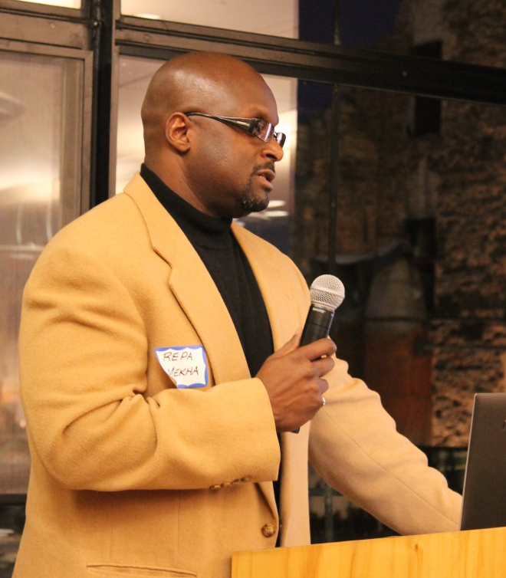
Why the BCLI at Nexus?
Program Goals
Hold priority seats
Leaders are technically and politically prepared and supported
Policies and resources changed to reflect and respond to community.
We see the BCLI on a broader leadership continuum given all of the other great leadership work in the community.
Notes:
Terri
Building relationship sharing where our strengths operate from: from us bottom up; for UH was top down

Slide 7
This is not your typical training program…
Social change tool to shape equitable policies at local government level
Focus on power & systems
Everyone has assets and is a leader but have not been as visible in formal decision-making circles
Accountability to a broader community
BCLI ensures outcomes are shaped by different voices & we are tracking the correct outcomes
Notes:
Terri

Slide 8
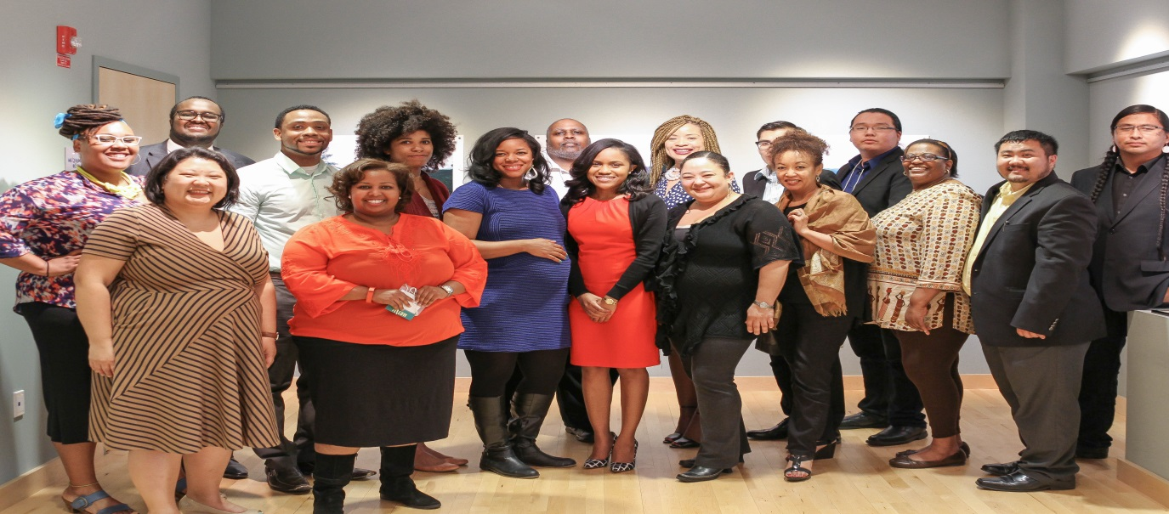
And we learn together…
Co-hort model is key to this work
As well as access to other networks, including:
Government, non-profit and private sectors
Advocacy, organizing and engagement groups
Community development, non-profit, transit, health
Notes:
Terri
We are accountable not just to community but to each other

Slide 9
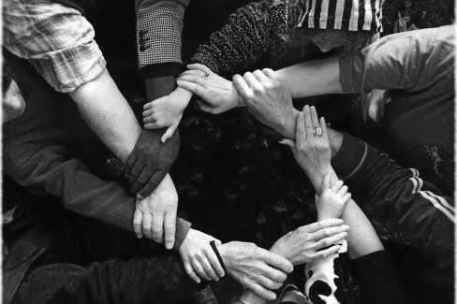
Our Vision of an Equity Agenda
A competitive, inclusive and sustainable region is one in which members of all racial, ethnic and income groups have:
more housing and transportation choices
is closer to jobs, shops or schools
is more energy independent and helps protect clean air and water
are equitably benefiting from local and regional opportunities
To achieve this, an equity agenda needs to be created that requires all sectors to participate, use of targeted strategies and focus on outcomes.
Notes:
Terri
Building relationship sharing where our strengths operate from: from us bottom up; for UH was top down
John powell work on targeted universalism

Slide 10
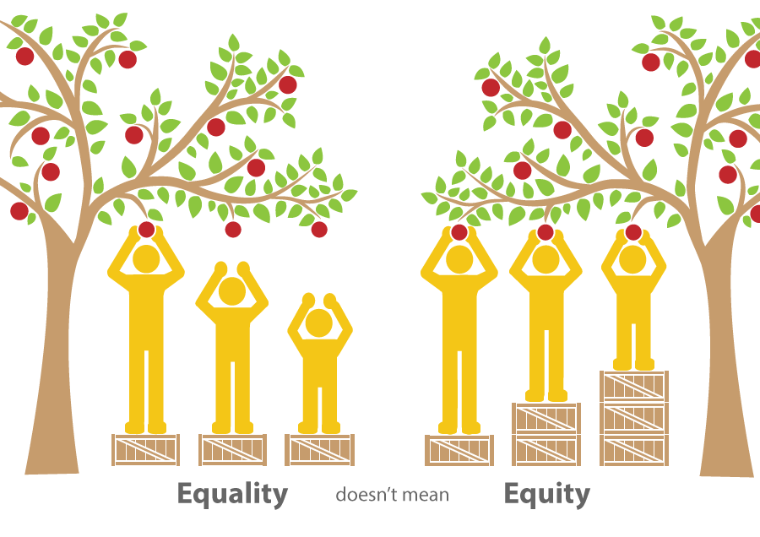
So What Do We Mean by Equity?
Equality v. Equity
"Equality means everyone gets a pair of shoes. Equity means everyone gets a pair of shoes that fit.“ Vernon Wall, co-founder, Social Justice Training Institute, www.stji.org
Equality = access, fairness, everyone is the same
Equity = differences among people; outcomes should be the same
PolicyLink, national organization working on equity defines it as: “Just and fair inclusion into a society in which all can participate, prosper and reach their full potential.”
Note that there are different types of equity: racial, gender, economic
Notes:
Terri
Building relationship sharing where our strengths operate from: from us bottom up; for UH was top down
John Powell work on targeted universalism

Slide 11
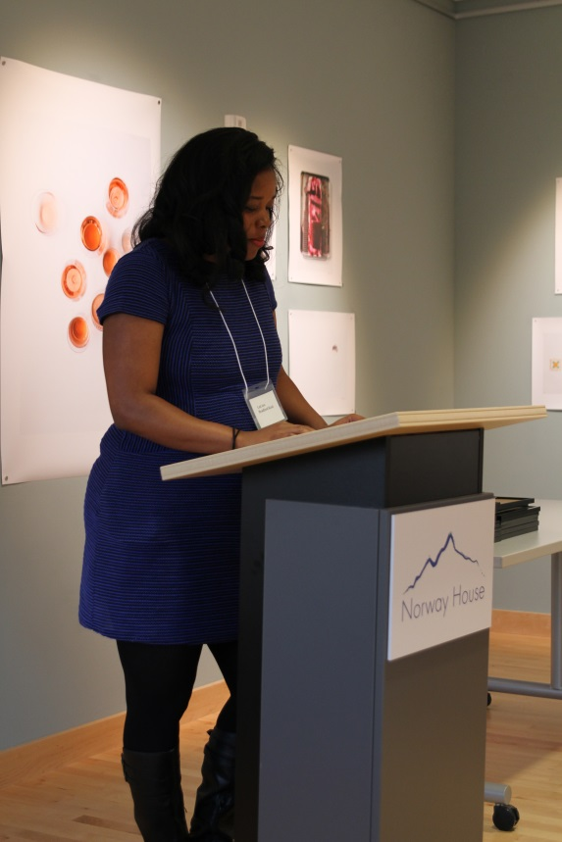
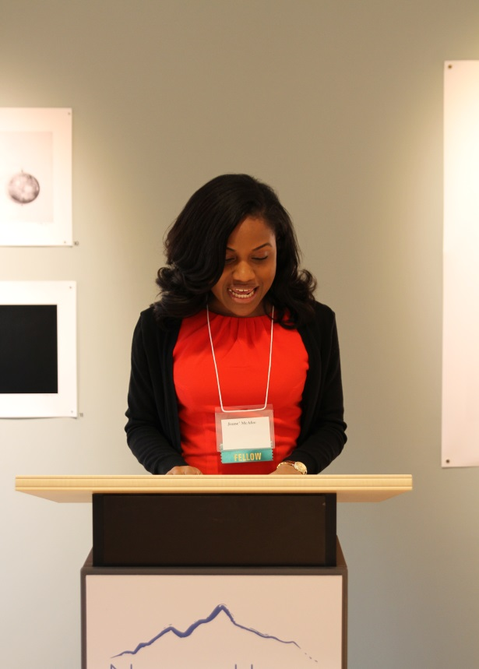
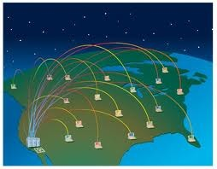
The BCLI Model
7-month leadership program that supports, trains, and places people of color and other underrepresented community members on priority, publically appointed boards and commissions that influence equity.
Train
Place
Connect
leaders to succeed technically and politically
equity advocates on priority seats
Local, regional and national networks
Bay Area, San Diego, Seattle, Central Valley CA, Detroit, Houston
Notes:
Terri

Slide 12
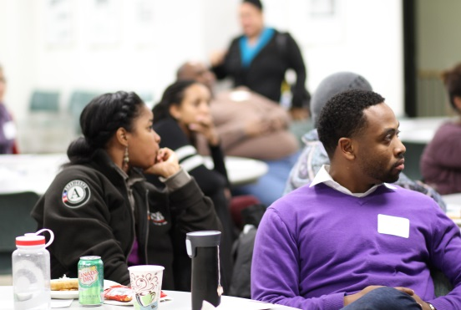
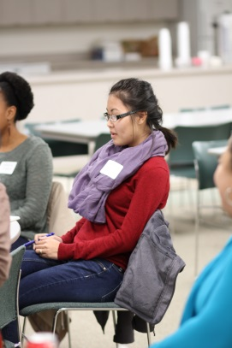
Why a board or commission? What exactly do they do?
Duties involve:
Review local/regional policies, plans and budget
Facilitate community input on public decisions
Incorporate public comments into policy
Research critical issues
Review agency reports
Make recommendations to agency, city council, mayor, etc. on decision-making and implementation
Make decisions on policies and implementation
Notes:
Terri

Slide 13
But what about boards of nonprofit organizations?
Non-profits are important community institutions but require a different skill set to navigate.
Since our focus is on systems change, we ONLY target publicly appointed city and county boards and commissions.
And we do NOT target nonprofit boards.
But Board Repair, a local group of people of color who sit on non-profit boards does! www.facebook.com/groups/boardrepair
Notes:
Terri

Slide 14
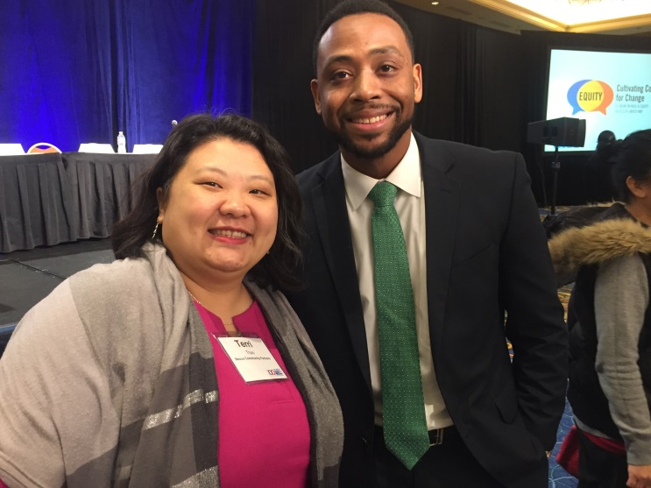
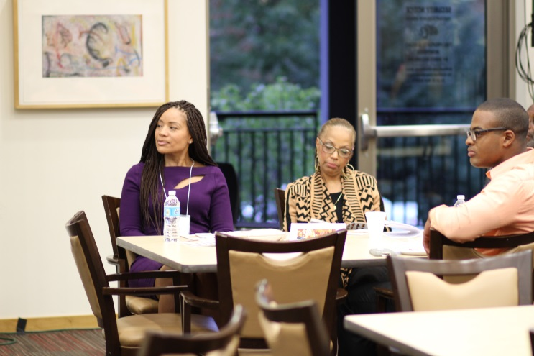
How does someone advocate as a commissioner?
Raise awareness about equity among stakeholders who do not consider the impact of their policies and decisions on communities of color and other underrepresented communities
Voice the equity perspective and offer solutions on public plans that impact your communities
Build visibility and power of community
Notes:
Terri

Slide 15
What’s policy and how does it differ from law?
Differences | Policy | Law
What are they? | Policies outline what government or organizations plan to do. They are guidelines, plans and vision statements all in one. | Laws set standards, principles, and procedures that must be followed in society.
Who makes them? PEOPLE | Committees, organizations, government entities | Electeds, judges, voters
What is our ability to change them? | Easier in some cases to change policy | Depends but can be harder to change laws once they pass
Notes:
Terri

Slide 16
BCLI: the Process
1. Target Seats
2. Organizations Nominate
Deadline July 1st
3. Select Cohort
Interviews end of August
4. Training
Oct-Mar, each month:
1 Saturday 9-5;
1. Thursday 5:30-8pm
5. Get Seated
You Apply.
We Support.
6. Help through Technical Advisory Network
7. Give Back, Connect, and Learn as Alumni
Notes:
Chai
Summary of the process

Slide 17
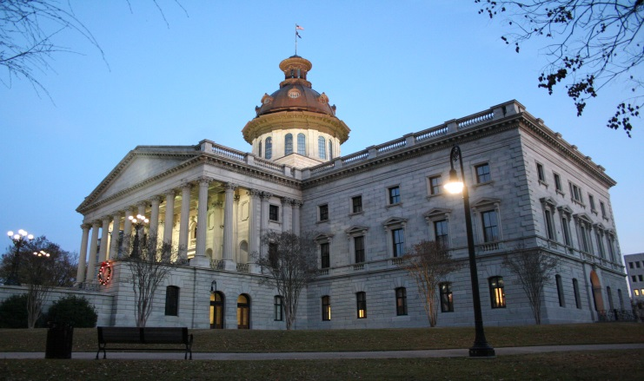
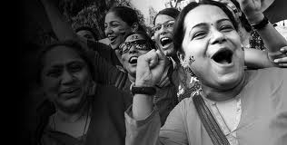
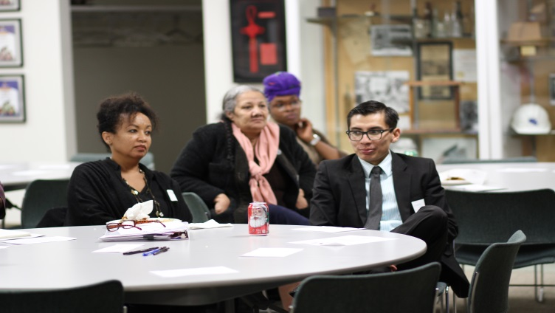
1. We Target Seats
Determine potential influence in advancing equity
Research Phase…
Determine culture & structure of board/commission
Narrow list to priority seats
Notes:
Terri
A total of 59 seats in our nominations packet this year – was just 28 in our first year;
Appointment Process and Placement Lift
Who are the gatekeepers?
How much leverage is required for placement?
What skills and experience required?
Potential for success in advancing social justice issues
What types of social justice issues addressed? How?
Current seated advocate commissioners? Potential allies?
Formal power of the Board
What are its domains of power?
To whom do they report? Within what Department?
What is the board’s relationship to policy?
Actual influence and informal power players

Slide 18
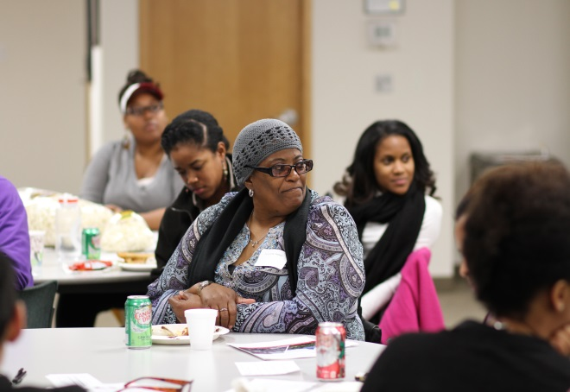
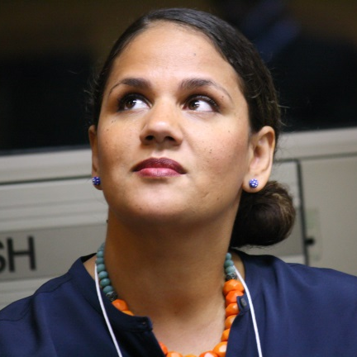
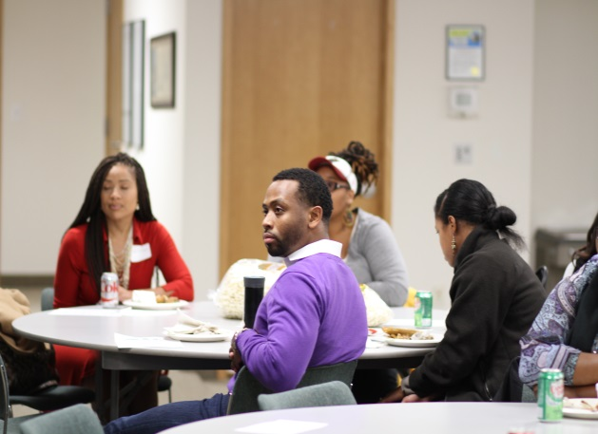
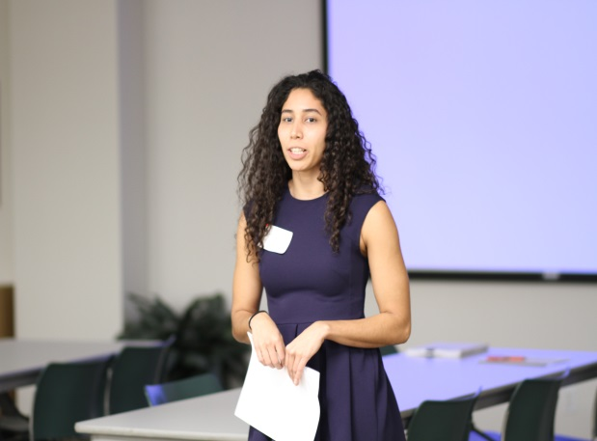
What issue areas do we target?
Economic Development
Housing Nexus knowledge
Jobs areas & networks
Transportation
Health
Notes:
Terri
Building relationship sharing where our strengths operate from: from us bottom up; for UH was top down

Slide 19
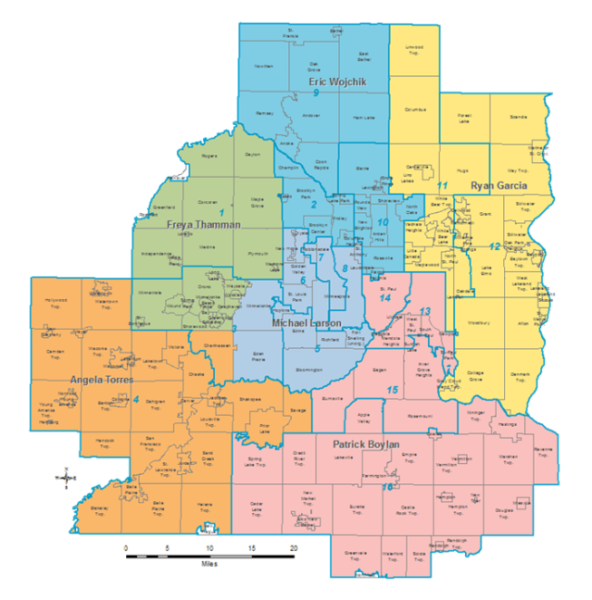
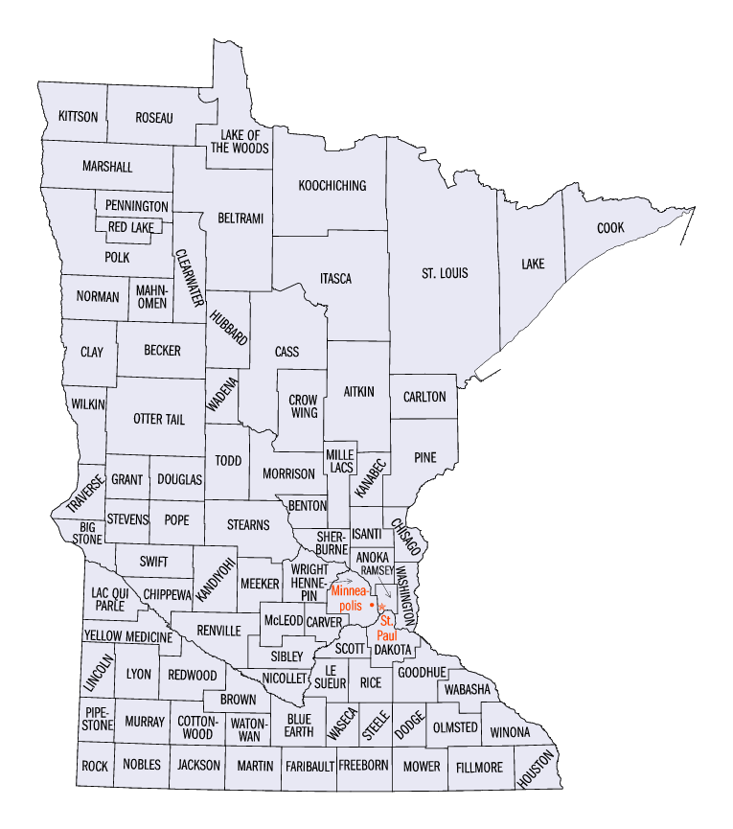
Target BCLI Geographies for 2016-2017
City of Minneapolis
City of St. Paul
City of Brooklyn Park
City of Brooklyn Center
Hennepin County
Ramsey County
Metropolitan Council Advisory Committees
State of Minnesota
(see Nomination Packet for full list of b/c’s)
Notes:
Chai

Slide 20
2. Organizations Nominate You (and you apply)
Who Nominates You? **
BCLI Alumni
Community & Economic Development
Faith-Based
Labor
Leadership Programs
Grassroots/Community Organizing
Government
Policy Advocacy
Nonprofit Organizations
**1 Organization can nominate 1 Candidate each year
& 1 Alum can nominate 1 Candidate each year**
Notes:
Chai

Slide 21
What is the Process?
From the Nominator:
Nomination Cover Sheet
Nominating Letter
From the Candidate:
Nominee Cover Sheet
Letter of Interest
Current Resume
(see pages 5-6 in the Nomination Packet)
Notes:
Chai

Slide 22
What if I am not affiliated with an organization?
Nexus can connect you!
Align by interest area
Nominations hold candidates accountable to a community, since the BCLI is not just your average leadership institute!
Notes:
Chai

Slide 23
3. How we select our cohort of 15
Income
Ability
Issue Familiarity
Sector
Ethnicity
Gender
Race
Region
Advocacy Experience
Residency
Passion
Sexual Orientation
Notes:
Chai

Slide 24
Cohort Composition
Notes:
Chai

Slide 25
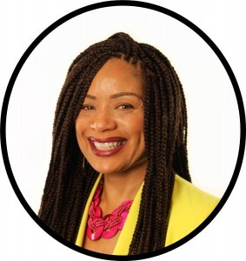
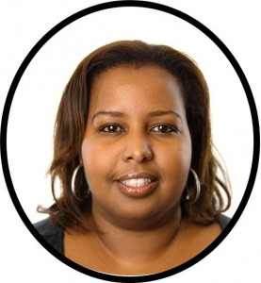
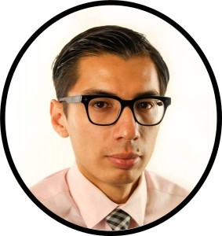
The Ideal Candidate
*Must*
Be committed to social, racial, and economic justice for people of color and other underrepresented communities. They must also have:
A racial equity analysis
An Understand impact of policy & role of systems
Experience (personal or professional) in advocacy and systems
Match residency requirements for board/commission (i.e. ward/district)
Be 18 years of age
Attend all monthly trainings/events (see page 3 in NP)
Commit to serve on a board or commission
Notes:
Chai

Slide 26
4. Training (7 months – October through April)
Each Month:
1 Saturday Session (9am – 5pm)
[Closed to cohort only]
1 Thursday Issue Series (5:30pm – 8pm)
[Open to public]
Online readings, webinars & discussions
Notes:
Chai

Slide 27
BCLI Curriculum Highlights
Knowledge Foundations
Transit & Mobility
Racial Equity
Land Use & Economic Development
Workforce Development
Health
Housing
Notes:
Terri

Slide 28
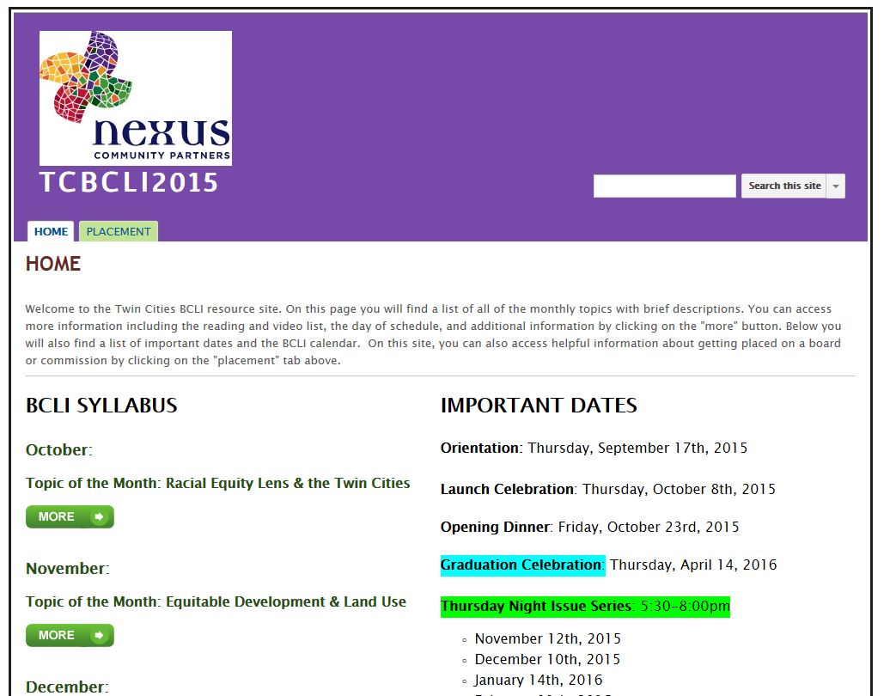
Google Groups & Fellow Benefits
Google Group
Post readings and videos
Power Analysis Caucuses (PACs) your individual smaller group of fellows
One on Ones with BCLI Staff
Stipend: $500
Notes:
Terri

Slide 29
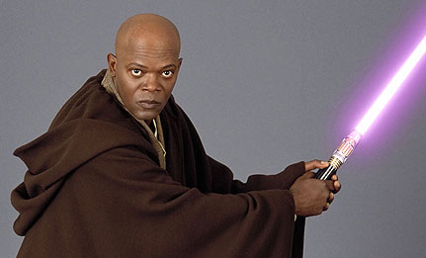
BCLI Curriculum Highlights
Political Skills: Technical Skills:
Organizing and Mobilizing - Robert’s Rules of Order
Leadership in Teams - Message Framing
Storytelling (My Personal Story) - Municipal Budgets
Self-care - Writing Resolutions
Negotiation & Persuasion - Commission Simulation
Creating Allies
Knowledge Integration Sessions:
Land Use Visioning
Evaluating Workforce Development Proposals
Community Benefits Agreements (CBA)
Transit-oriented Development (TOD) Trade-offs
Health Equity
Which sounds the most interesting to you?
Least interesting?
Notes:
Chai

Slide 30
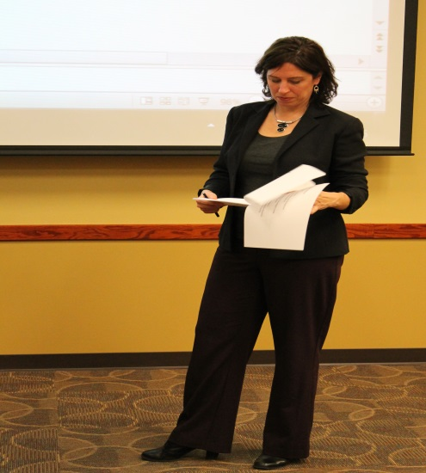
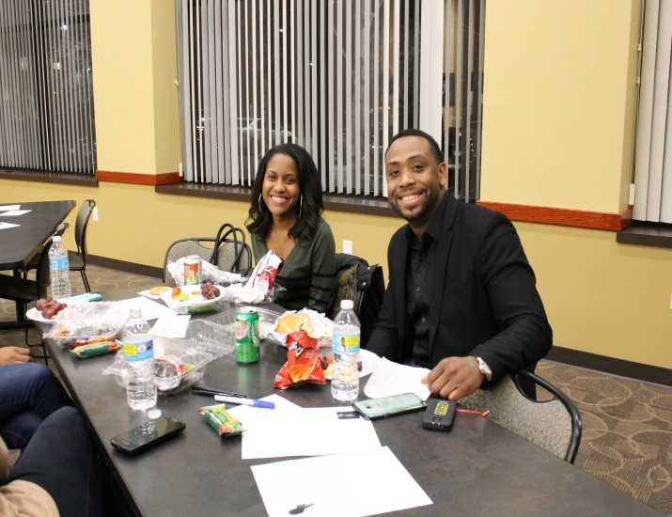
5. Getting Seated: You Apply. We Support.
Advice & Action Plan
Application Review and Interview Prep
Leverage Relationships & Rally Support
Notes:
Terri
We work with cohort members and potential cohort members year-round to ensure a fluid placement process.
As outlined above, we help prospective commissioners with applications, work behind the scenes, and turn out support when it makes sense.
Relationship building is key.
Understanding individual jurisdiction culture is necessary.

Slide 31
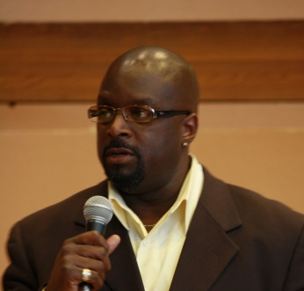
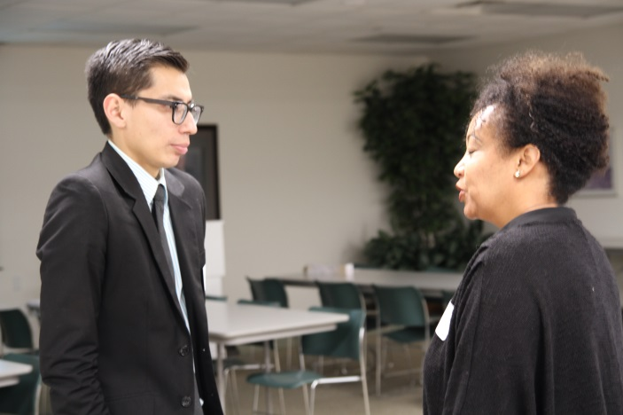
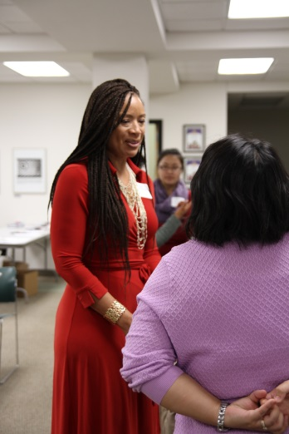
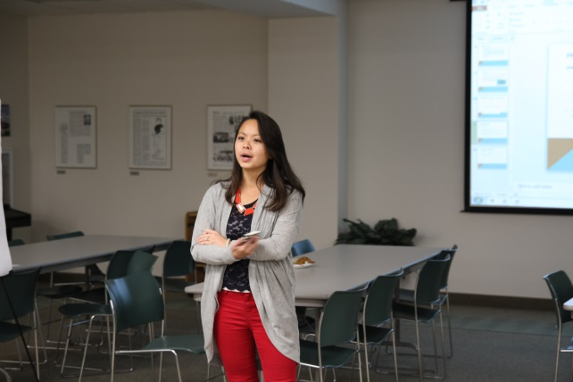
6. Expand Networks and Get Support
Emails
Economic Development
Health
Housing
Transit
Workforce Development
Lunches
Phone calls
Notes:
Terri

Slide 32
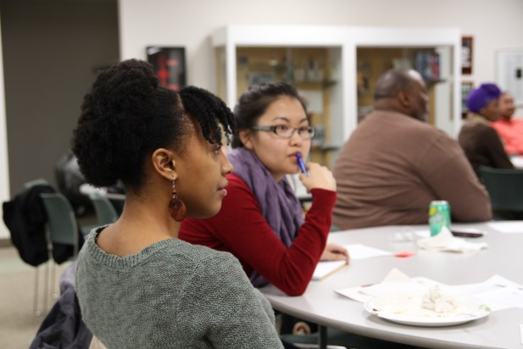
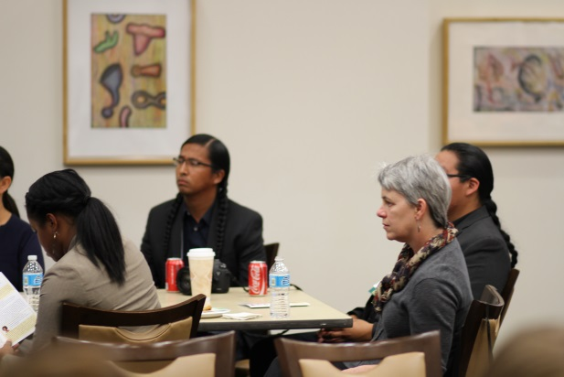
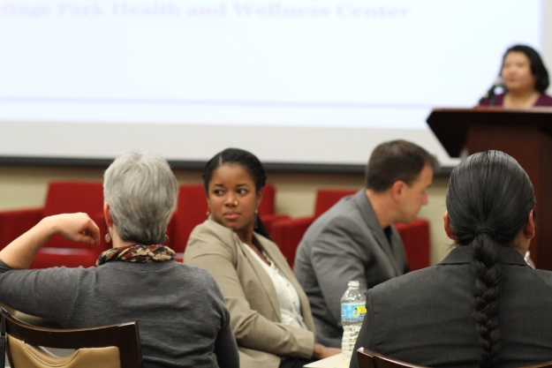
Thursday Night Issue Series
2015-2016 Issue Series Topics:
Intersectionality
Economic Development, part 1 & 2
Fined and Dimed: Impact of Transit Fines and Fees on Low-Wealth Communities
Parks Equity
Examples of Speakers Included:
Diane Tran, MN Rising
Katya Pilling, Knutson Construction
Cameron Downey & Canaan Ray-Strong, Juxtaposition Arts
Teresa Nelson, MN ACLU
Chaka Mkali, Hope Community
Dr. Raintry Salk, Metropolitan Council
Notes:
Terri

Slide 33
7. Give Back, Connect and Learn as Alumni
Professional Development
Best Practice Sharing
Continued Learning Opportunities
Networking and Socializing
Selecting and training new BCLI Cohorts
Notes:
Terri
Share current alumni plan

Slide 34
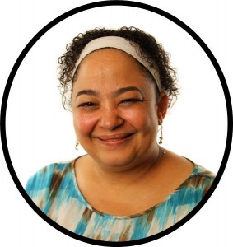
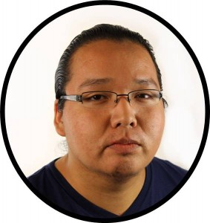
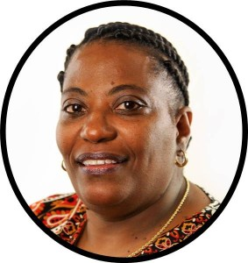
Twin Cities BCLI Alumni
41 graduates:
Minneapolis: 25
St. Paul: 14
Other (suburbs): 2
40 identify with a community of color; one as white low-wealth community member
Outcomes include: increased leadership, visibility and effectiveness
Notes:
Terri

Slide 35
Placements
Twin Cities: 3 Cohorts
22 of 41 placed or serve as policy staff for electeds
Board & Commission Placement Examples:
Ramsey County Workforce Investment Board
Minneapolis Community Environmental Advisory Committee
Metropolitan Council Transportation Advisory Board
Oakland: 8 Cohorts
101 graduates total
Examples of Bay Area Boards & Commissions placed:
Oakland Housing Authority
Richmond Economic Development Commission
San Francisco Public Utilities Commission Community Advisory Committee
Notes:
Terri
Building relationship sharing where our strengths operate from: from us bottom up; for UH was top down

Slide 36
Important Dates 2016-2017
May 2nd: Nominations Open
July 1st: Nominations Close
August: Interviews Conducted
Week of September 6th: Announce Cohort
October 6th: Launch Event
October – March: Training Sessions
April 13th: Graduation
Notes:
Terri

Slide 37
Thank you!
Terri Thao
Program Director
(651) 379-0505
tthao@nexuscp.org
Chai Lee
Program Coordinator
(651) 289-7029
clee@nexuscp.org
Applications online at www.nexuscp.org
Like us on Facebook! www.facebook.com/nexuscp

